Slide 1


Internship Stage
Presented: Hoang Truong Pham

Slide 2
Stage Information
The stage course is 420-EP6-AS C2_WORKPLACE INTEGRATION
The stage starts from May 1st to June 21th 2024
My stage company is Nouvel Horizon Cananda
My stage manager is Florence Ho
My stage goals are database management and website related to immigration service

Slide 3

Week 1
Database Management 1/5 – 3/5

Slide 4




Wednesday (1/5)
Stage Discussion
Having logical business with manager
Download necessary tools

Slide 5
Thursday (2/5)
Design UI of the project
UIs: Homepage of database management, general idea for Creation and List pages for Admin, Employer, Worker

Slide 6

Continue and Finish designing UIs of Creation and List Pages for Admin, Employer, Worker
Book Title. P52
Friday (3/5)

Slide 7
Week 2
Database Management 6/5 – 10/5

Slide 8




Monday (6/5)
Setting up packages: npm, electron, electron-builder
Start coding UI of Admin, Employer, Worker List with HTML and CSS

Slide 9

Tuesday (7/5)
Searching the method to deploy the Electron project as executable file
Finishing the code UI of Admin, Employer, Worker List

Slide 10


Wednesday (8/5)
Start coding UI of Admin, Employer, Worker Creation Pages with HTML and CSS

Slide 11
Thursday (9/5)
Continuing the coding UI of Admin, Employer, Worker Creation Pages

Slide 12
Friday (10/5)
Finishing the code UI of Admin, Employer, Worker List
Start working on Javascript of Admin, Employer, Worker List

Slide 13
Week 3
Database Management 13/5 – 17/5

Slide 14
Monday (13/5)
Continuing the operation of Admin, Employer, Worker List with the requirements
Research how to work with CRUD operation in MongoDB

Slide 15


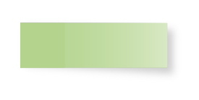
Tuesday (14/5)
Continuing the operation of Admin, Employer, Worker List with the requirements

Slide 16

Wednesday (15/5)
Finishing the operation of Admin, Employer, Worker List
Modifying some details the UI of Employer List

Slide 17


Thursday (16/5)
Start working with operation of Admin, Employer, Worker Creation Pages
Research how to store files in MongoDB

Slide 18
Friday (17/5)
Continuing the operation of Admin, Employer, Worker Creation
Continuing working on store file in MongoDB

Slide 19
Week 4
Database Management 20/5 – 24/5

Slide 20

Monday (20/5)
Finishing the operation of Admin, Employer, Worker Creation
Start working on the UI of Admin, Employer, Worker Update

Slide 21
Continuing the UI of Admin, Employer, Worker Update
Tuesday (21/5)

Slide 22
Wednesday (22/5)
35%
65%
Continuing the UI of Admin, Employer, Worker Update
Start decorating UI of Admin Employer Worker Update Pages with CSS

Slide 23

Thursday (23/5)
Finishing the UI of Admin, Employer, Worker Update
Start working on the UI of Admin, Employer, Worker Delete

Slide 24

Friday (24/5)
Continuing the UI of Admin, Employer, Worker Delete

Slide 25
Week 5
Database Management 27/5 – 31/5

Slide 26


Monday (27/5)
Monday (27/5)
Finishing the UI of Admin, Employer, Worker Delete
Start decorating UI of Admin, Employer, Worker Delete with CSS

Slide 27
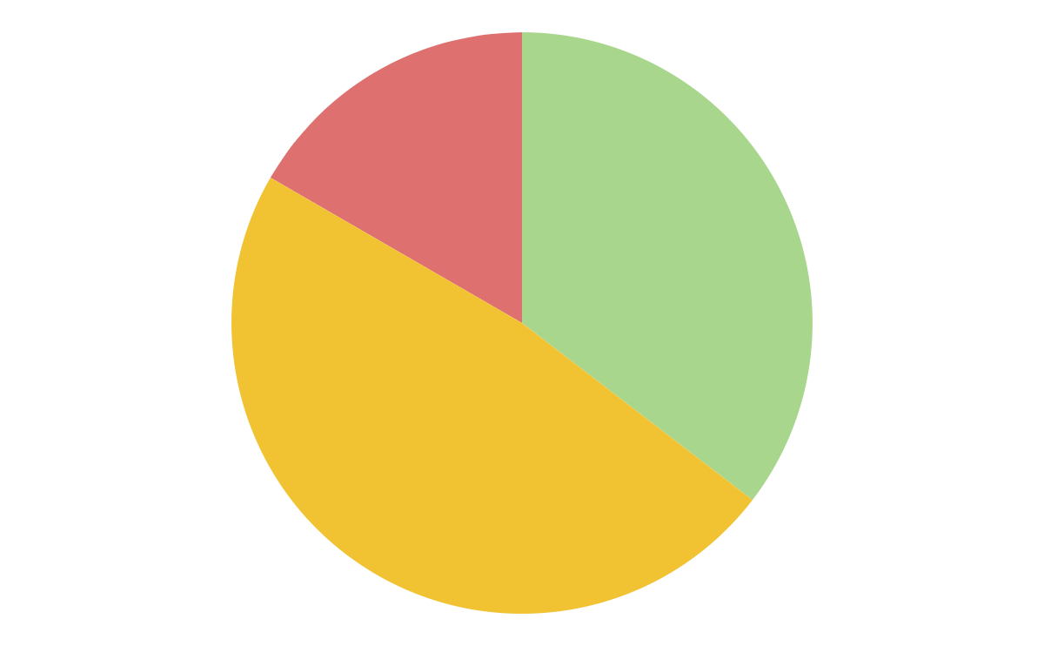
Tuesday (28/5)
Continuing decorating UI of Admin, Employer, Worker Delete with CSS

Slide 28


Wednesday (29/5)
Step 1
Step 2
Start working on the operation of Admin Employer Worker Update with Javascript
Finishing the decoration of UI of Admin, Employer, Worker Delete

Slide 29
Thursday (30/5)
Continuing the operation of Admin Employer Worker Update

Slide 30
Friday (31/5)
Continuing the operation of Admin Employer Worker Update

Slide 31
Week 6
Database Management 3/6 – 7/6

Slide 32


Monday (3/6)
Finishing the operation of Admin Employer Worker Updaters

Slide 33
Tuesday (4/6)
Tuesday (4/6)
 |  |  |  | 1 | 2 | 3
4 | 5 | 6 | 7 | 8 | 9 | 10
11 | 12 | 13 | 14 | 15 | 16 | 17
18 | 19 | 20 | 21 | 22 | 23 | 24
25 | 26 | 27 | 28 | 29 | 30
Start doing the operation of Admin, Employer, Worker Delete with Javascript

Slide 34
Wednesday (5/6)
Continuing doing the operation of Admin, Employer, Worker Delete

Slide 35
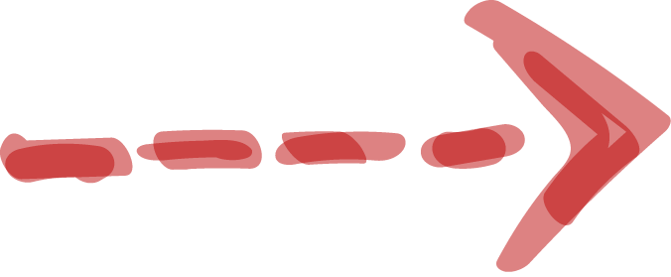
Thursday (6/6)
• Start creating UI of Login Page with HTML and CSS
Finishing doing the operation of Admin, Employer, Worker Delete

Slide 36


Friday (7/6)
Finishing UI of Login Page
Complete the Login Operation

Slide 37
Week 7
Website 10/6 – 14/6

Slide 38



Monday (10/6)
First Day
Second Day
Tuesday (11/6)
Start designing Index page with Figma
Start coding Html and CSS of page Index

Slide 39
Week 7
Wednesday
(12/6)
Continuing and finish the Index page
Thursday (13/6)
Start designing About page with Figma
Friday (14/6)
Start coding and finish Html and CSS of About page

Slide 40
Week 8
Website 17/6 – 21/6

Slide 41

A little brainstorming
Monday (17/6)
Designing Service page with Figma
Tuesday (18/6)
Start coding and finish the Service page
Wednesday (19/6)
Start designing Contact page with Figma

Slide 42
Thursday (20/6)
Friday (21/6)
Start coding and finish Html and CSS of Contact page
Complete Contact Form API

Slide 43
Technology
Electron
HTML
Figma
CSS
MongoDB
Javascript
PHP

Slide 44
Assigned Role
Front-end
Design UI
Full-Stack Developer
Back-end
Data Layer and Business Layer
Tester
Analyze and Testing

Slide 45

After Stage
Learn different soft and hard skill
Experience real-life work in IT

Slide 46

Thank You

